Slide 1
Feed - it
Presented by:
Ozan Gokdemir and Brianna Igbinosun

Slide 2
Problem and Solution
Problem: Hard to give good feedback or reactions without full knowledge of the situations, however there will be many times a teacher will not have the full context of a situation in those case, the teacher will need to react as best that they can.
Solution: Practice and be better prepared in choosing their reactions and learn about other reactions that they could use

Slide 3

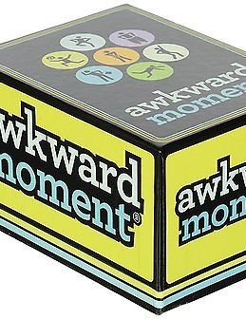
Inspiration
Original Game
Pay Attention Focused on practicing giving non-verbal feedback
Results
Many issues in game
Scraped idea and looked more broadly
Examples
speech by Deborah Ball, President of the American Educational Research Association
Awkward Moments

Slide 4
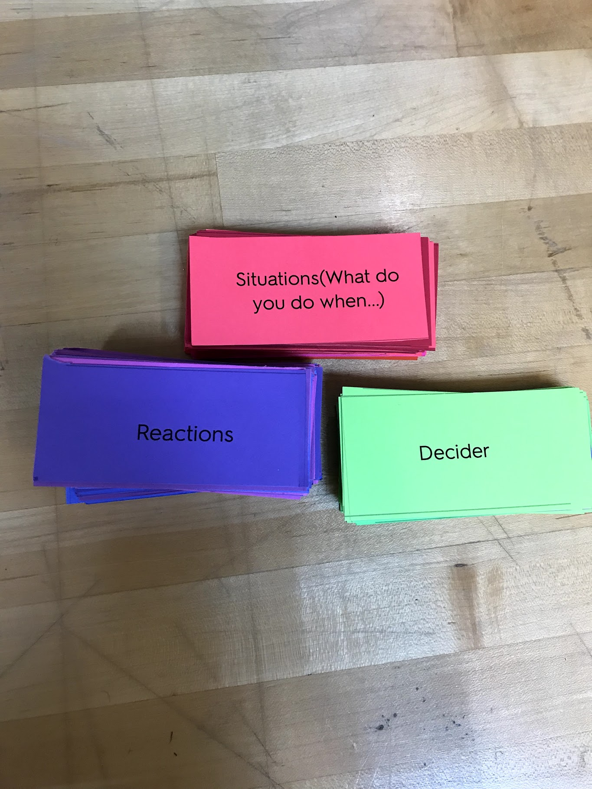
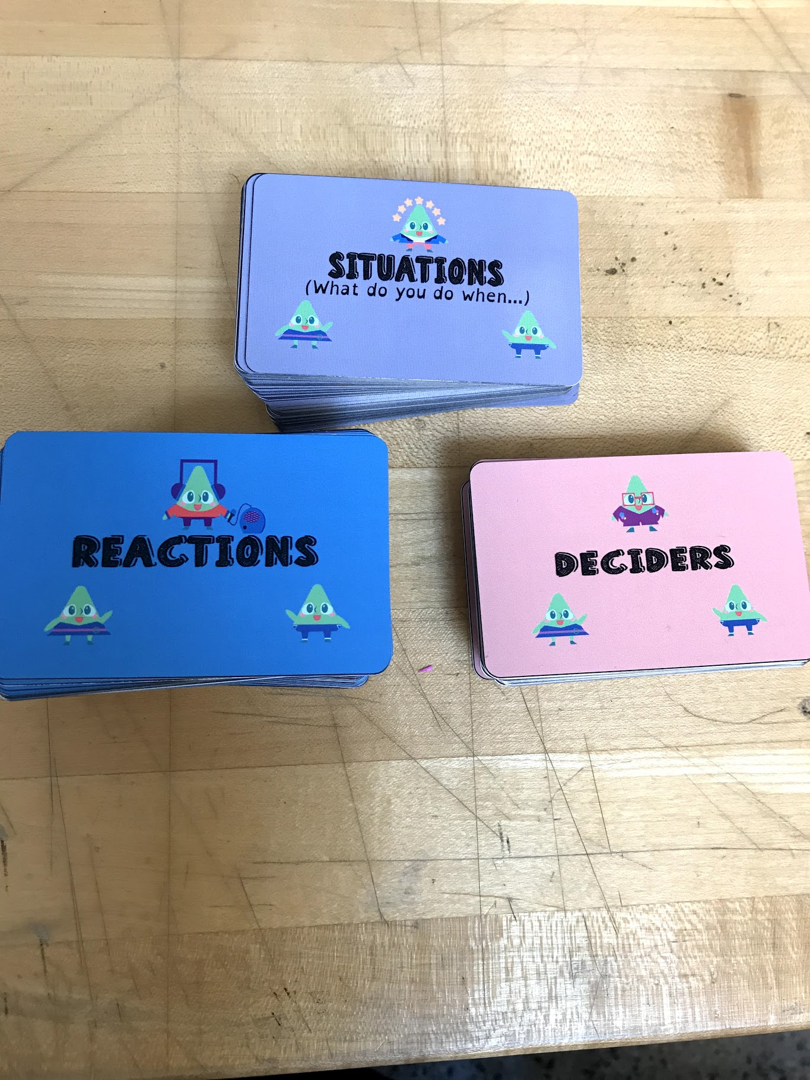
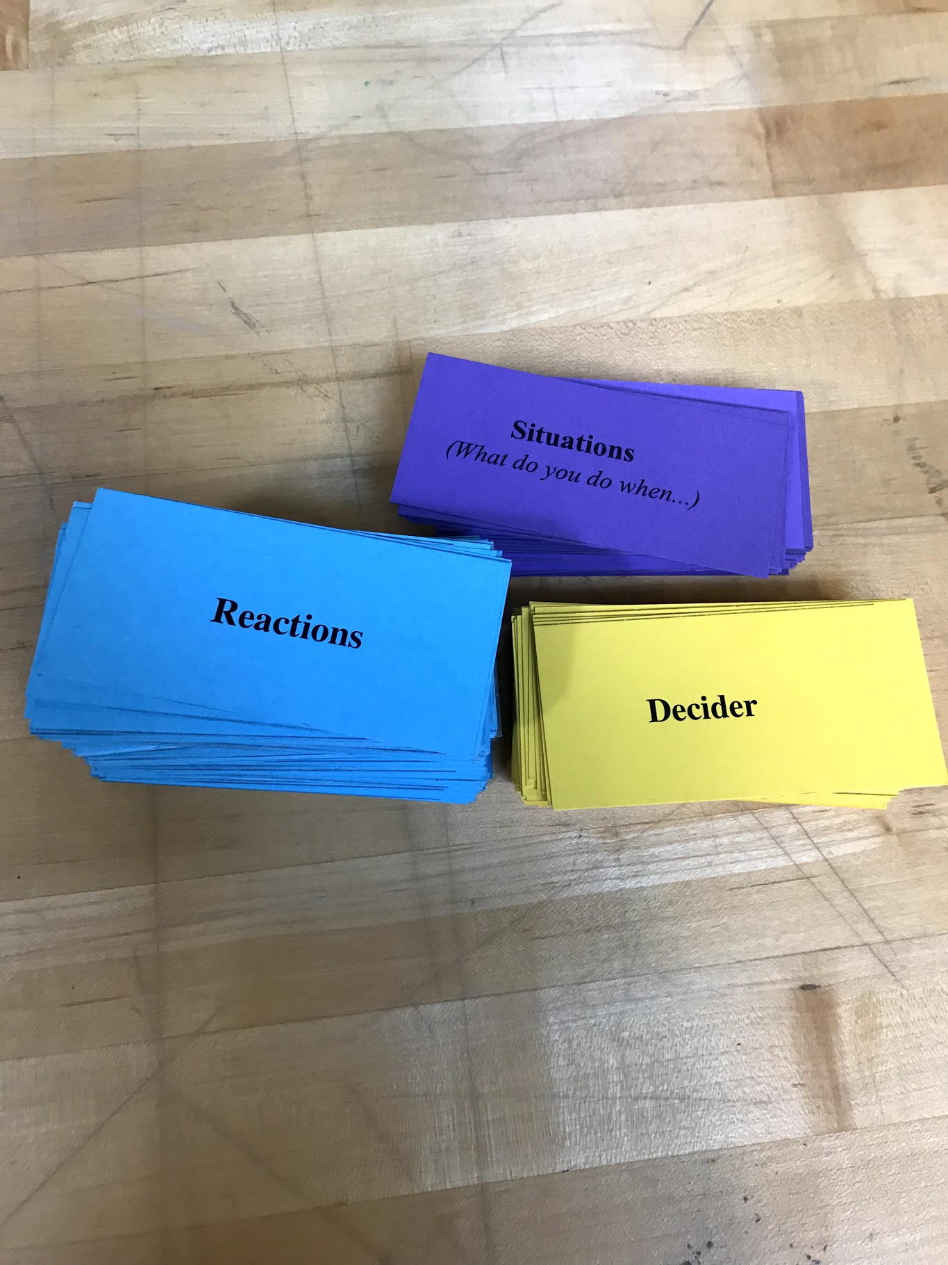
Revised Solution
1st Prototype
Let the teachers discover their own good and bad feedbacks
Peer review
Giving good feedback is about being willing to listen and share and not talk down or act like the law
Focus on letting the players learn the good & bad reactions and the reasoning behind them
New game:
Feed-it
Current Game
2nd Prototype

Slide 5
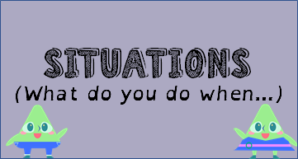
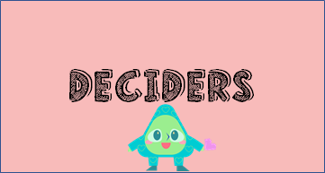
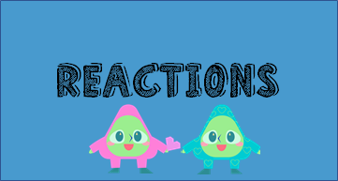
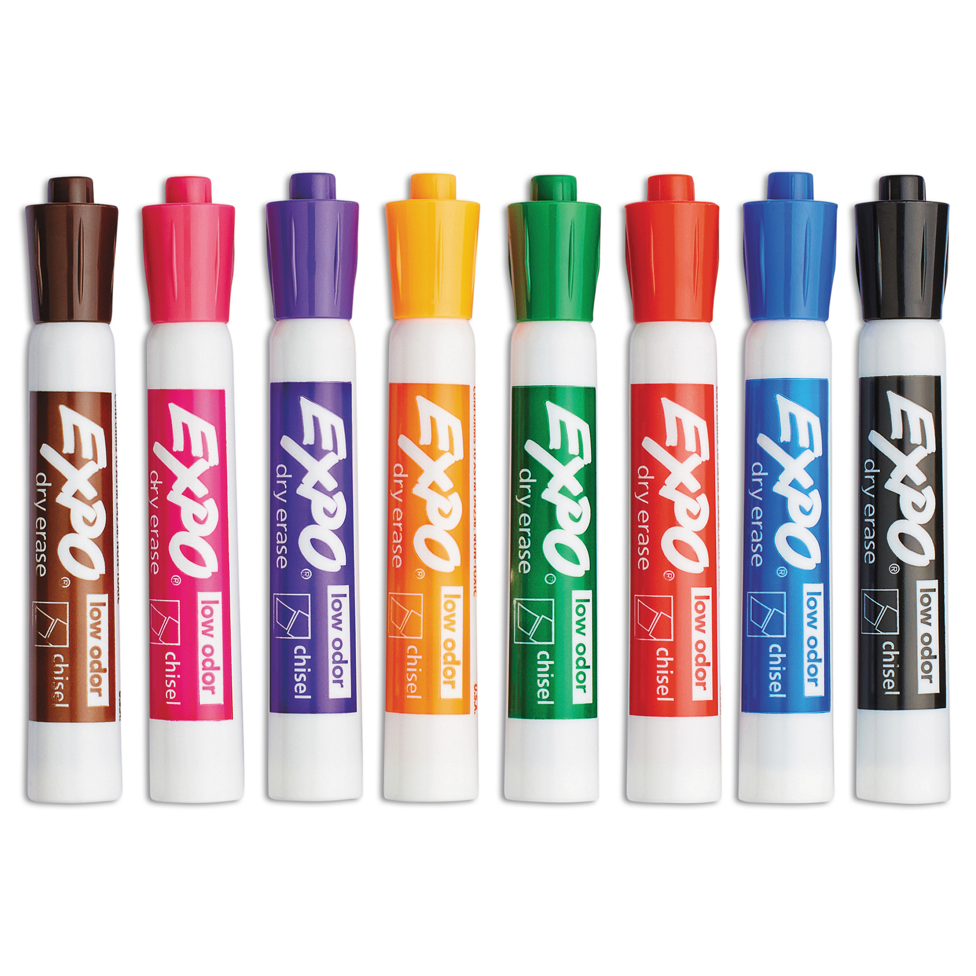
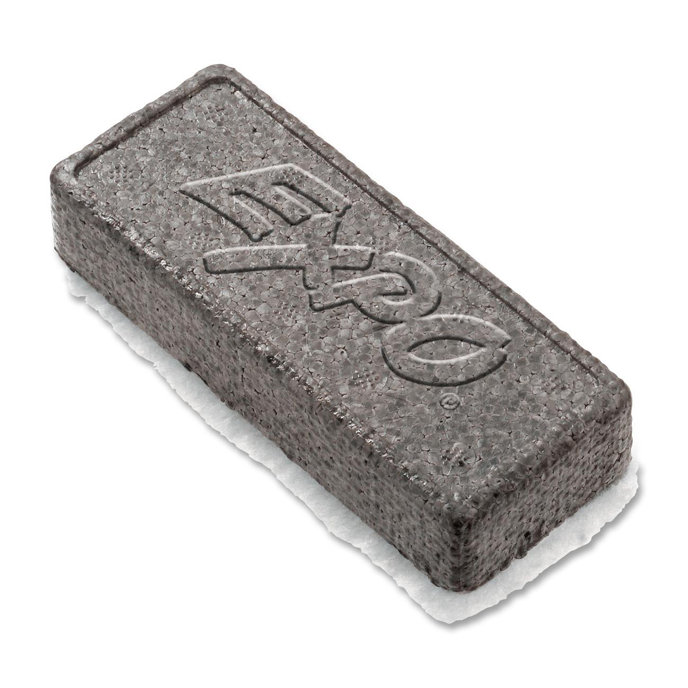
Feed - it
Description:
Teaching reactions with card-based discussion game
Summary
“Players will learn about different reactions while going through random situations and deciders and really show the other players and the judge why their reaction is the best. ”
Logistics
3-7 players
15-45 minutes

Slide 6
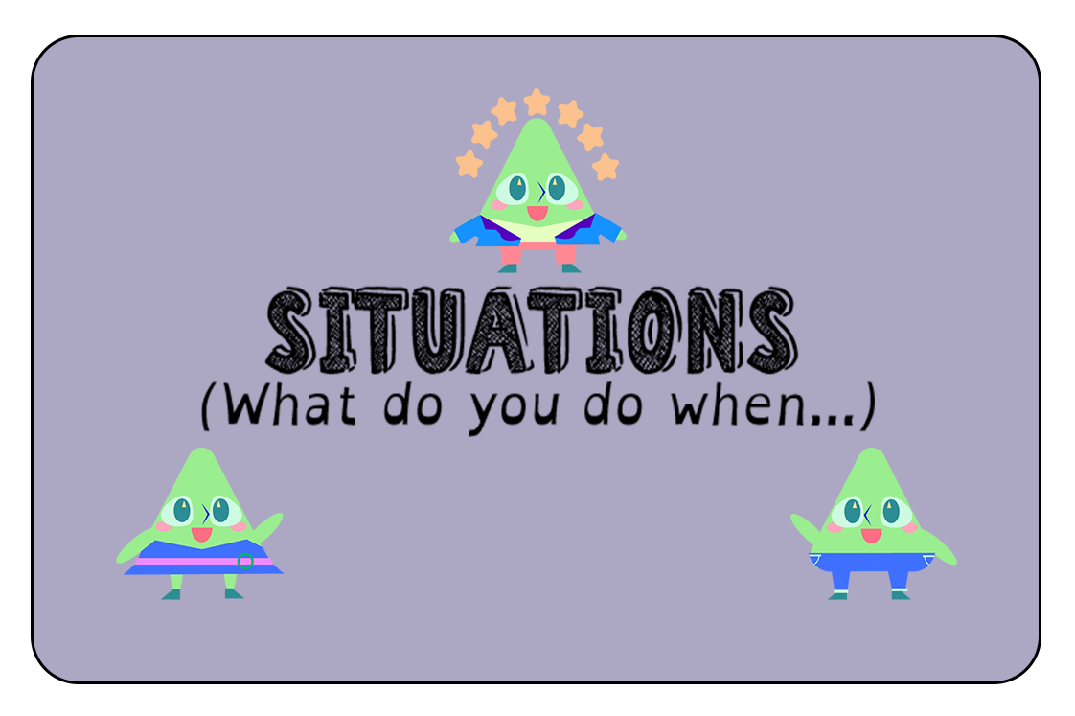
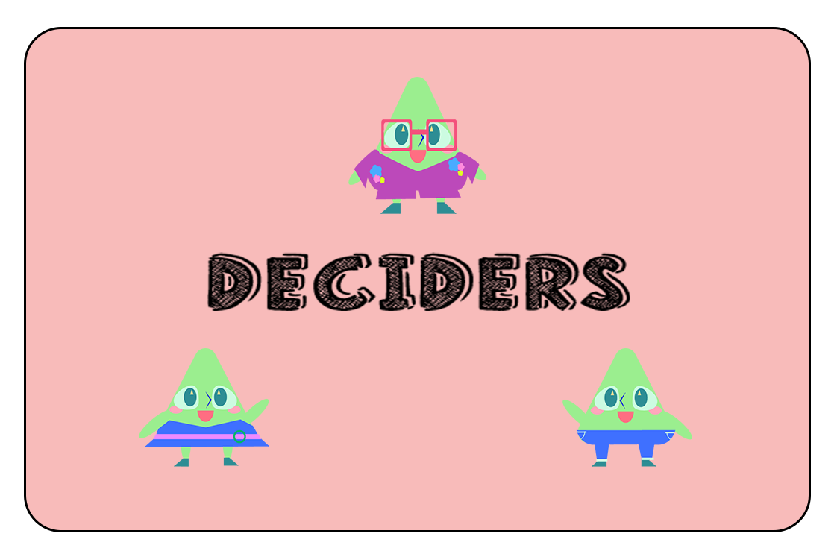
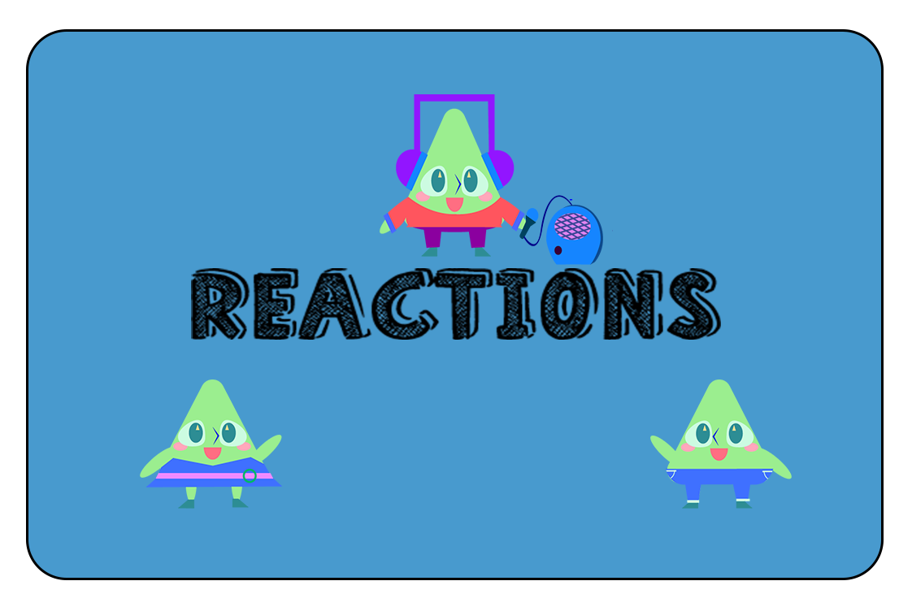
Feed - it
87 Situation Cards
65 Decider Cards
122 Reaction Cards + 10 Write-In Reaction Cards.
Marker and erasers

Slide 7
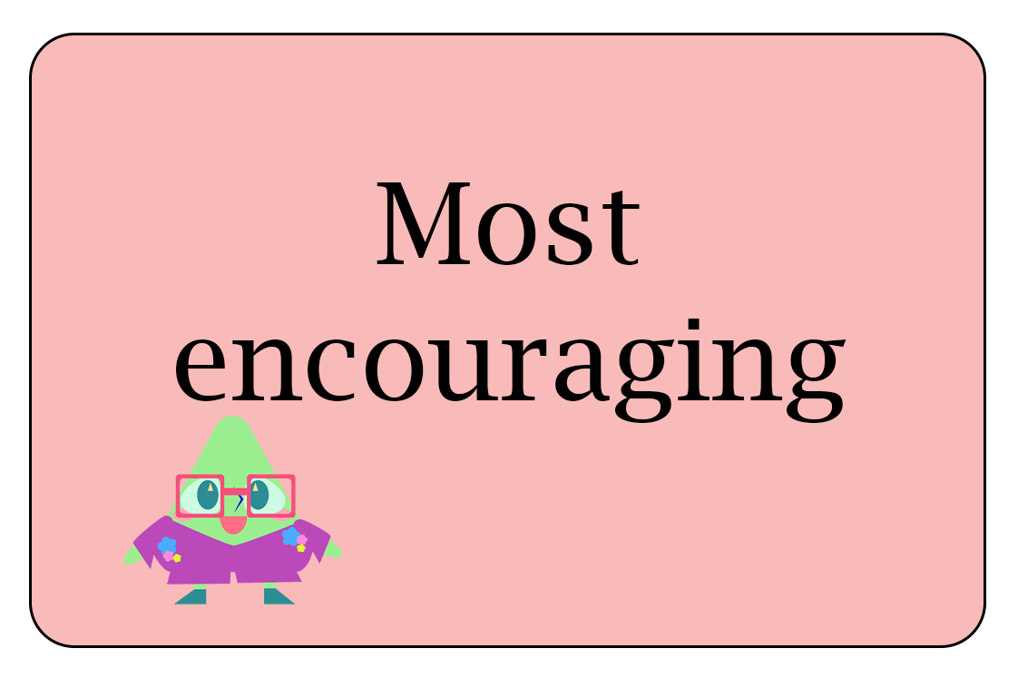
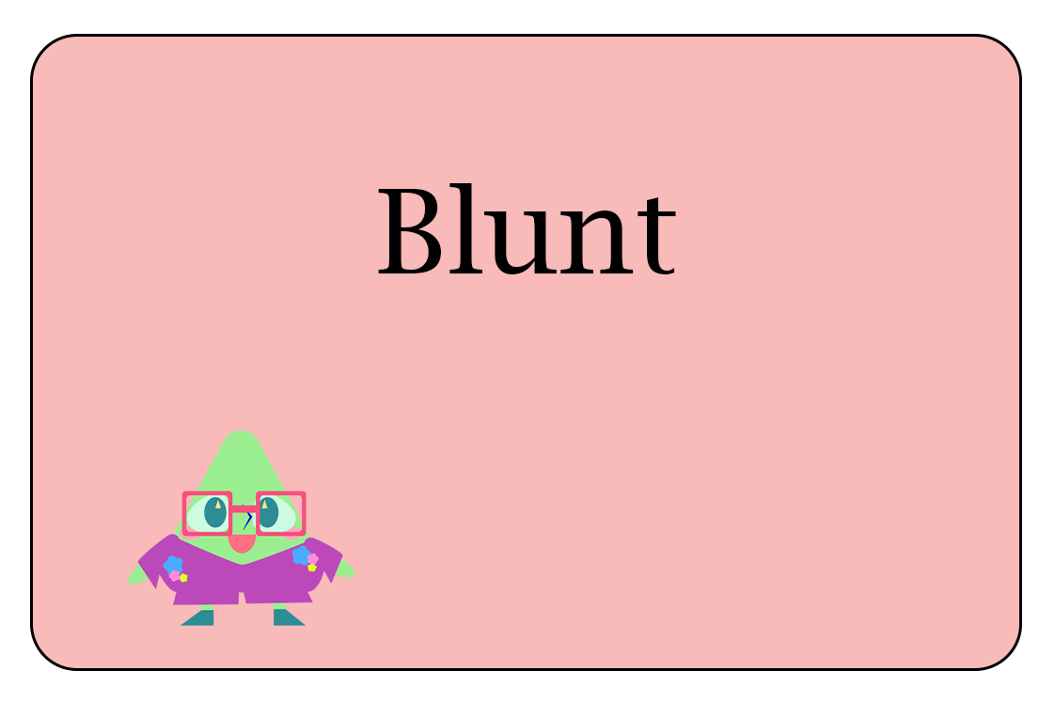
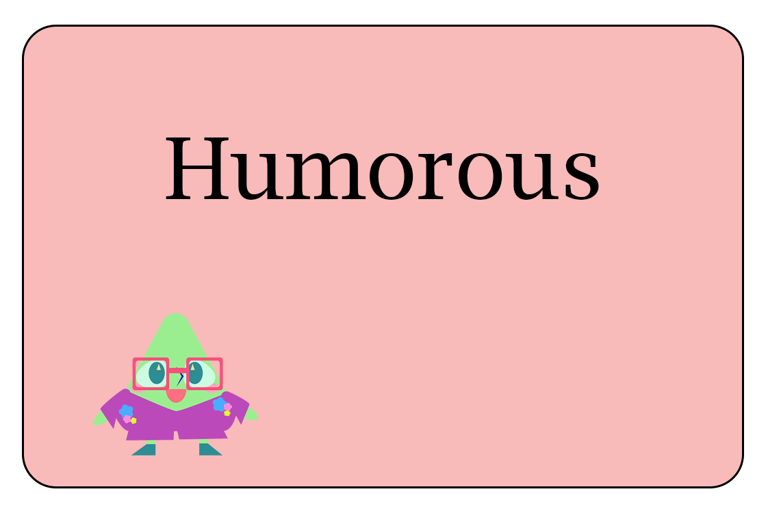
Feed - it
Decider Cards

Slide 8
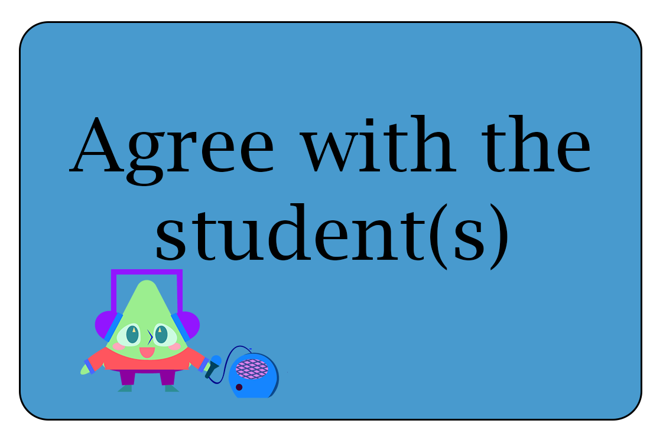
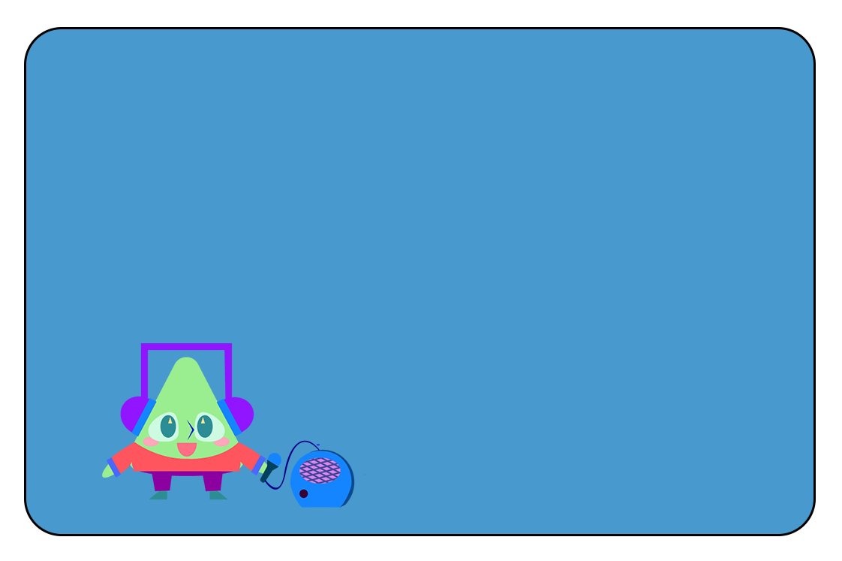
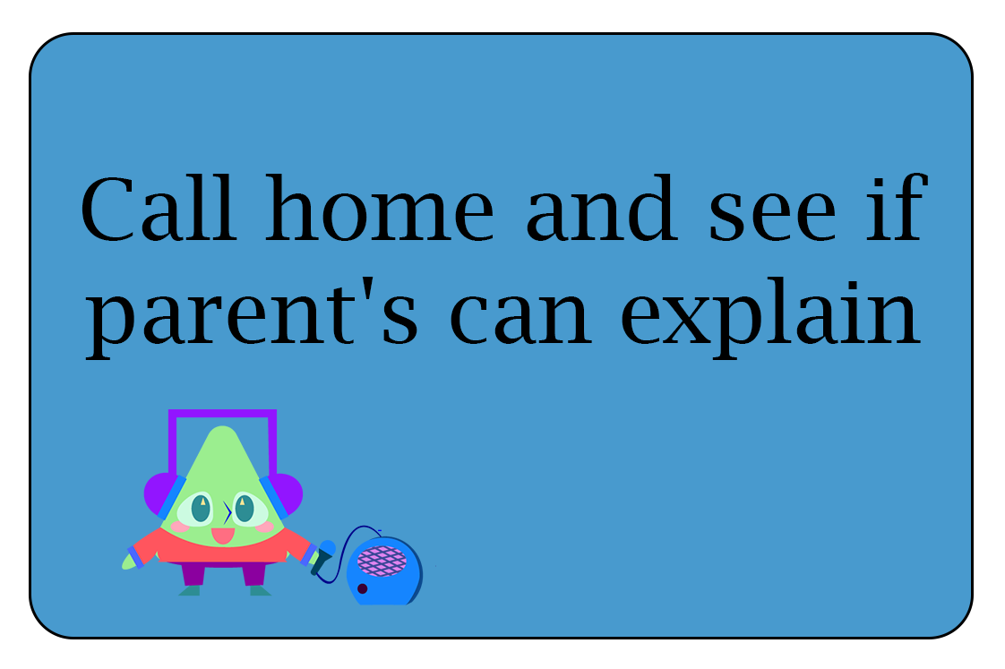
Feed - it
Reaction Cards
Pre-made
Write-ins

Slide 9
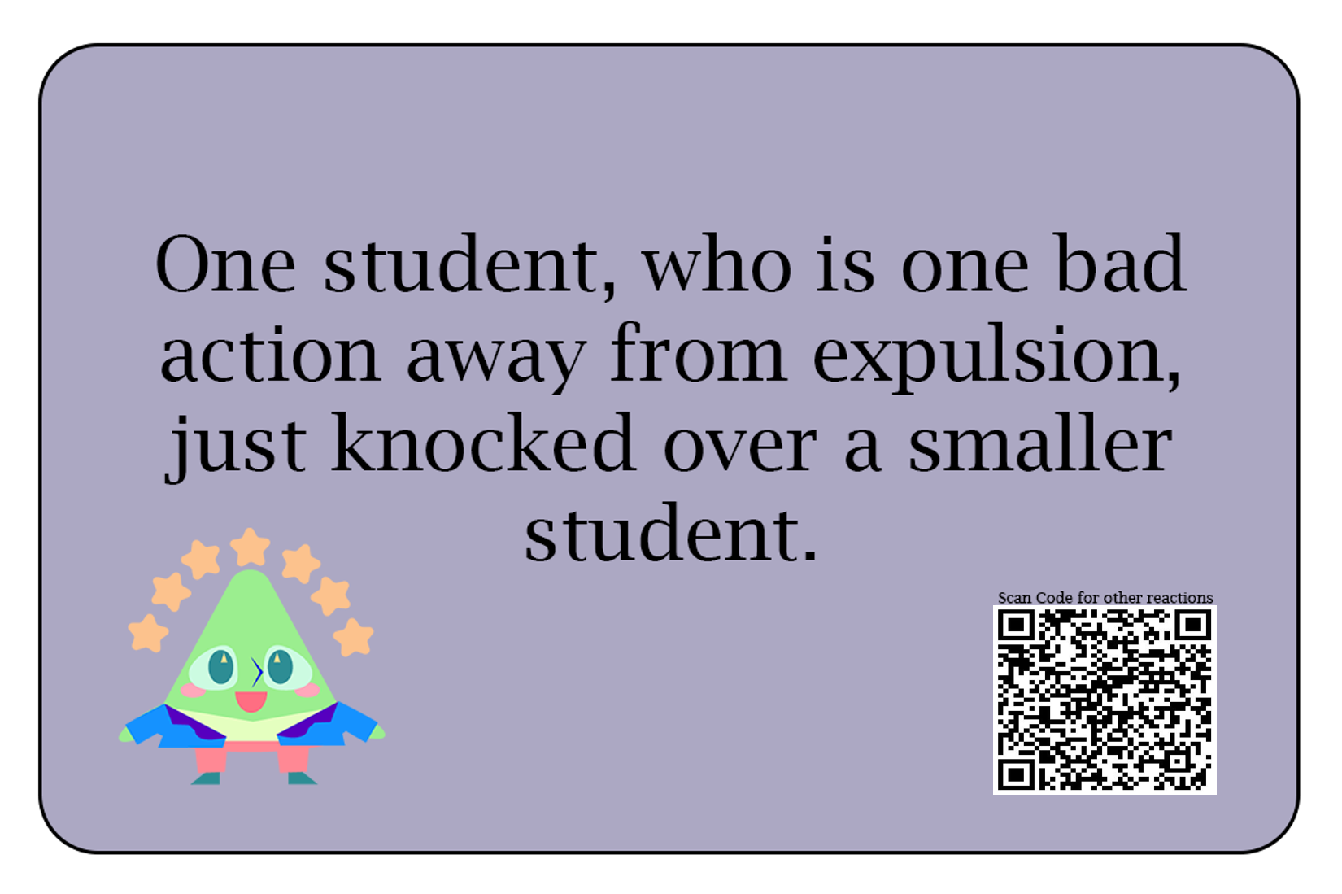
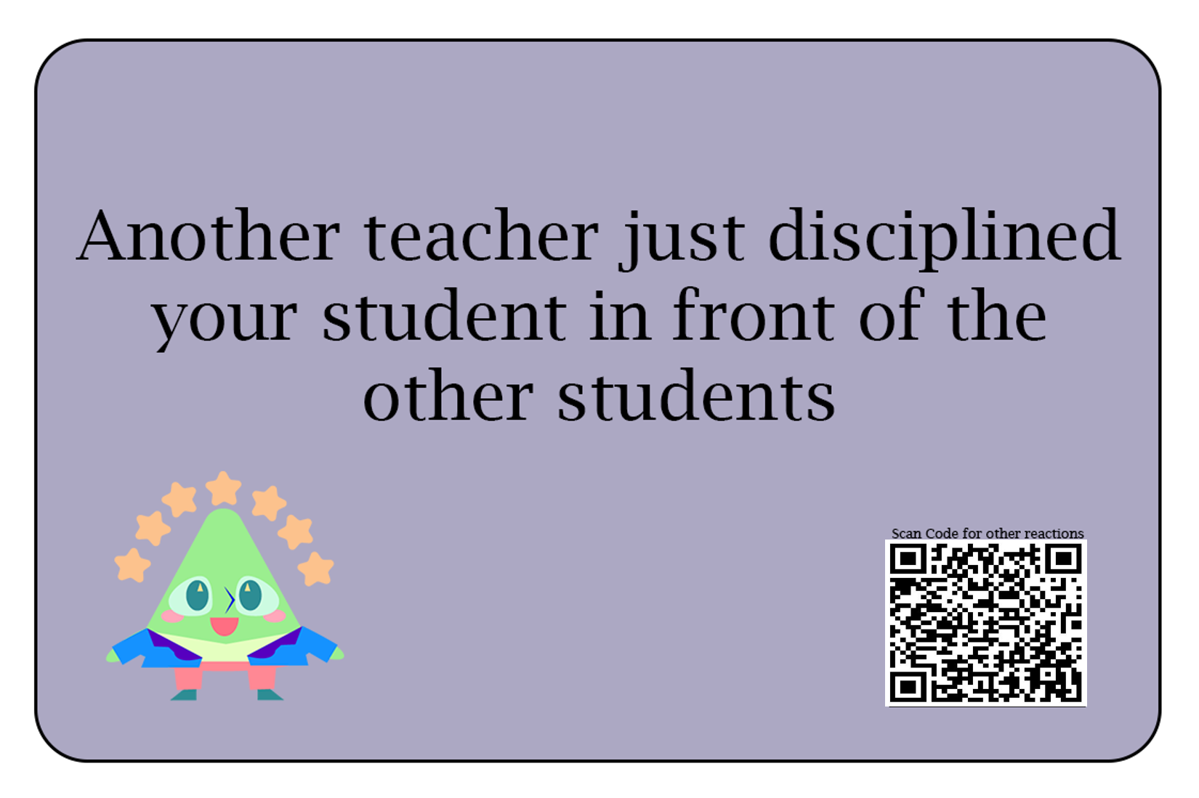
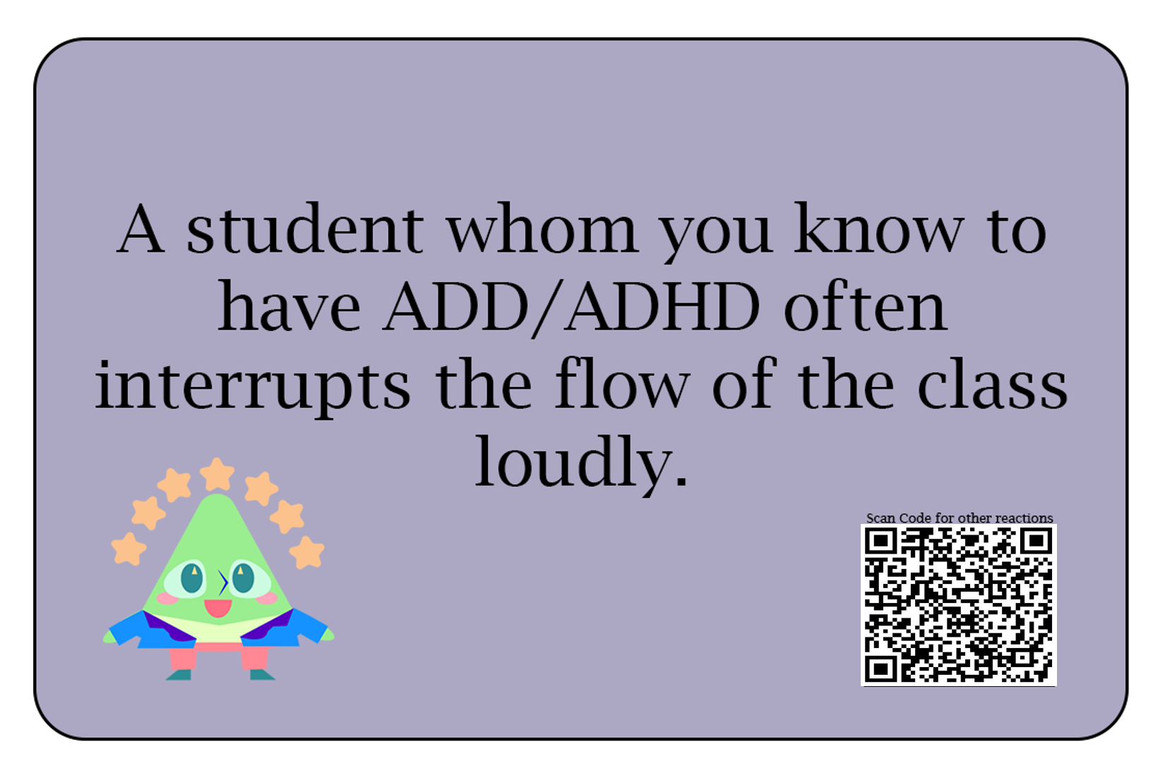
Feed - it
Situation Cards
Teacher-Student Interaction
Teacher-Authority Interaction
Student Support Interactions

Slide 10
Feed - it
Web App Demo (Pictures)

Slide 11
Feed - it
Learning objectives:
Learning how to react in situations with little information
Experiment with good and bad reactions and explaining
Learn more reactions and understanding the reasons and consequences from them
Use Listening and Sharing to facilitate a more playful feedback system
Develop a sub-conscious bank of different reactions for many situations
Learning science principles
Listening and Sharing
Feedback

Slide 12
Findings and Changes from Playtests
Balancing Fun and Learning can be difficult
Games can come in layers
Different parts of games can teach different things
Focus on who your audience in during playtest
Opinions on playtest may not be applicable to the intended audience
Managing around uncontrolled circumstances
Making rules to make people discuss regardless of group dynamics
Lowering the amount of write in cards if more people are good at giving reactions

Slide 13
Final (Current) Feed - it
Practice Space
7 stage rounds
Learn, React, ExAct, Judge, InVest, Switch, Repeat
2nd round follows same format
Decider is “the best”
Write-ins
Web-based Android App
Add wining reaction from second round with Qrcode scanner
View other reactions and explanations
Authentication added

Slide 14
Strengths and Shortcomings
Strengths
Fun to play and people see the learning goal
Can be played multiple times
Understandable rules
Web Application
Shortcomings
Haven’t practice the second stage of the game
Not enough positive reactions
No test on whether players are learning how to react better (data)

Slide 15
Future Development
What the game needs to have
More playtests
More positive reaction cards
System to allow other players to create their own reactions, situations and deciders in the first game
What would be nice for it to have
More versions of the game
Verified situations from teachers
Verified reactions from teachers

Slide 16
Future Development
Interesting Branches
Situation + Reaction
Decider + Reaction
Discussion facilitator
Historical Goal:
Constantly evolving deck
People archive reactions for future people to view
Learn from many people even at different time

Slide 17
Personal Summary
Future plans
Review of UROP:
Overview: Learning about each other → Learning about game design → Getting comfortable working with each other → Dividing groups based on problems from people’s interest → Group Common theme while small groups think of game

